Slide 1
Naive Bayes CLASSIFIER
Presented By
Anusha g s

Slide 2
CONTENTS
Introduction
What is Naive Bayes Classification
Different Types of Naive Bayes Classification
Mathematical Representation
Advantages and Disadvantages
Applications

Slide 3
Introduction
Naive Bayes is a term that is collectively used for classification algorithms that are based on Bayes Theorem.
Naive Bayes is based on Bayes Theorem, which was proposed by Reverend Thomas Bayes back in the 1760’s.
Naive Bayes Classifier is the Supervised Machine Learning Algorithm.
Naive Bayes is one of the simplest Machine Learning algorithms that has always been a favorite for classifying data.

Slide 4
What is naive bayes
Naive Bayes Classifier is one of the simple and most effective Classification algorithms which helps in building the fast machine learning models that can make quick predictions.
It is a probabilistic classifier, which means it predicts on the basis of the probability of an object.
It is mainly used in text classification that includes a high-dimensional training dataset.

Slide 5
Probability, Conditional Probability, and Bayes Theorem
Probability : The measure of the likelihood of an event to happen.
Example: if you throw a die, then the probability of getting 1 is 1/6
Formula : Probability of an Event = Number of Favorable Events / Total Number of Outcomes.
0 <= Probability of an Event <= 1
Conditional Probability : The possibility of an event or outcome happening, based on the existence of a previous event or outcome.

Slide 6

Mathematical Representation:
P(B|A) = P(A and B)/P(A)
Bayes Rule : Bayes' theorem is also known as Bayes' Rule or Bayes' law, which is used to determine the probability of a hypothesis with prior knowledge.
It depends on conditional probability.
Formula :

Slide 7
Where,
P(A|B) is Posterior probability: Probability of hypothesis A on the observed event B.
P(B|A) is Likelihood probability: Probability of the evidence given that the probability of a hypothesis is true.
P(A) is Prior Probability: Probability of hypothesis before observing the evidence.
P(B) is Marginal Probability: Probability of Evidence.

Slide 8
Types of Naive bayes classifier
Gaussian Naive Bayes Classifier
Bernoulli Naive Bayes Classifier
Multinomial Naive Bayes Classifier

Slide 9
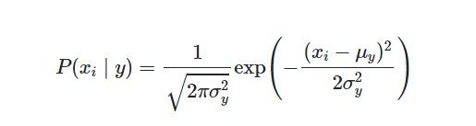
Gaussian Naive Bayes classifier
This classifier is employed when the predictor values are continuous and are expected to follow a Gaussian distribution.
When working with continuous data, an assumption often taken is that the continuous values associated with each class are distributed according to a normal (or Gaussian) distribution.
Formula:

Slide 10

Bernoulli NAIVE BAYES CLASSIFIER
It only takes binary values.
The most general example is where we check if each value will be whether or not a word that appears in a document.
Bernoulli distribution has two mutually exclusive outcomes : P(X=1)=p or P(X=0)=1-p.
In Bernoulli Naive Bayes theorem, we can have multiple features but each one is assumed to be binary valued variable i.e. boolean.
Formula:

Slide 11
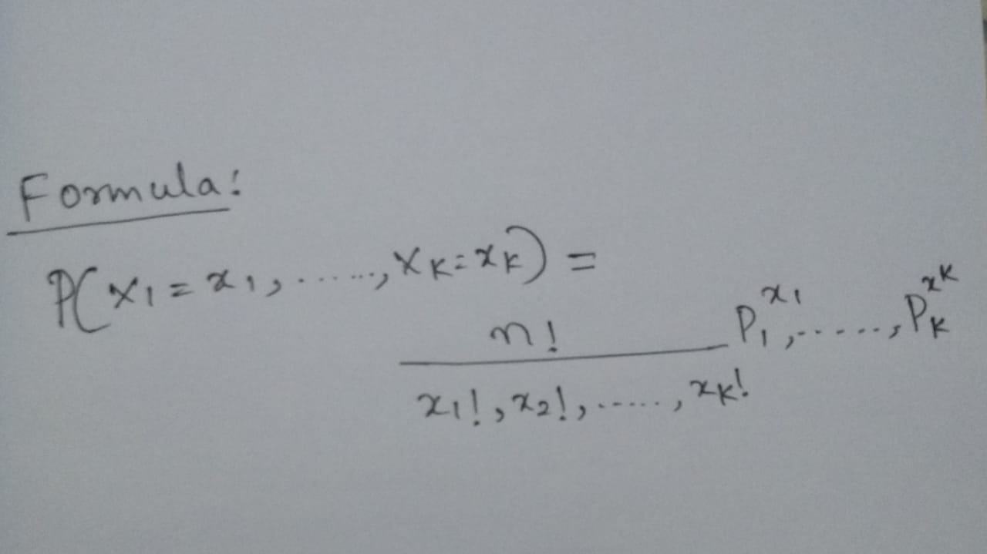
Multinomial Naive Bayes Classifier
Multinomial Naive Bayes algorithm is a probabilistic learning method that is mostly used in Natural Language Processing (NLP).
The algorithm is based on the Bayes theorem and predicts the tag of a text such as a piece of email or newspaper article.

Slide 12
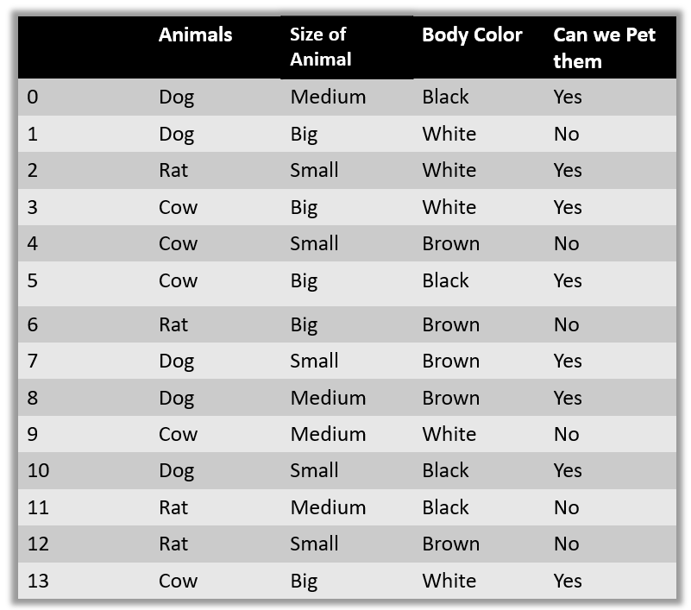
Example of naive bayes classifier

Slide 13
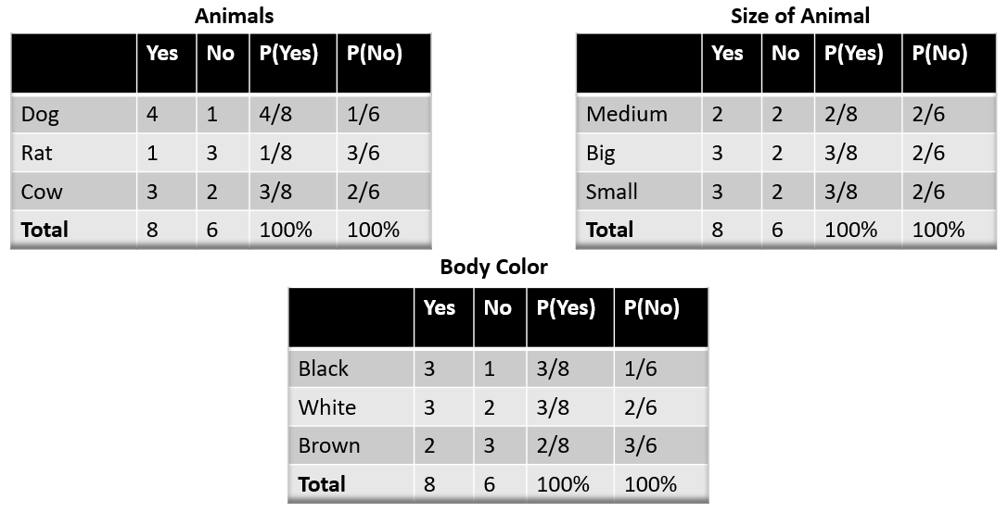
Assumptions of examples

Slide 14
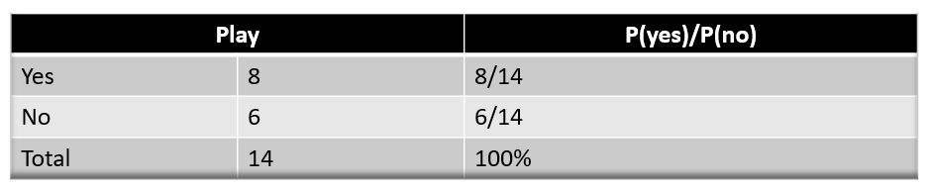
New test data to be classified, suppose test = (Cow, Medium, Black)

Slide 15

Probability of petting an animal :

Slide 16

And the probability of not petting an animal:

Slide 17
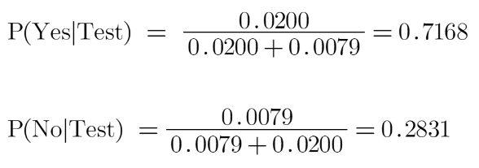
We know P(Yes|Test)+P(No|test) = 1
So, we will normalize the result:
We see here that P(Yes|Test) > P(No|Test), so the prediction that we can pet this animal is “Yes”.

Slide 18
Advantages
It is easy to implement as you only have to calculate probability.
You can use this algorithm on both continuous and discrete data.
It is simple and can be used for predicting real-time applications.
It is highly scalable and can easily handle large datasets.

Slide 19
DISADVANTAGES
The prediction accuracy of this algorithm is lower than the other probability algorithms.
It is not suitable for regression.
Naive Bayes algorithm is only used for textual data classification and cannot be used to predict numeric values.
If a categorical variable has a category in the test data set, which is not observed by the model in the training data, it will assign a 0 (zero) probability and not be able to make a prediction. This is often referred to as “Zero Frequency”.
To solve this problem, we can use the smoothing technique. One of the simplest smoothing techniques is called Laplace estimation.

Slide 20
APPLICATIONS
Face recognition
Weather prediction
Medical diagnosis
Spam detection
Sentimental analysis
News classification

